Slide 1
PREDICTIVE ANALYSIS
(Techniques and Applications)
Suraj Naikwade
Shaosheng Yin
Yarshil Shah

Slide 2
SMART, FAST AND INVISIBLE
Analytics is a hot field today, and more companies than ever are applying the power of analytics across their business.
These firms are competing based on analytic innovation, moving up from simple Business Intelligence to the power of predictive analytics.
As predictive analytics is being used for more than 50 years, new techniques has developed up till now and being applied them to a wide range of business problems.
Whether you are a business manager or an analytic scientist, this section will help you advance your knowledge of predictive analytics.

Slide 3
Understanding Predictive Analytics “Predicting behavior puts Big Data to work”
The cashier swipes your card and smiles. Before he hands it back, complex mathematical models hundreds of miles away crunch the data: If you've hit your credit limit, should it be extended? Is it really you using the card?
This is an everyday example of predictive analytics at work. Organizations of every size are using predictive analytics to unlock value in data and make smarter decisions about their customers.
Making the right business decision requires the ability to manage enormous complexity—especially when it involves customer behavior. When considering thousands of data factors and a universe of millions of customers, predictive analytics "connects the dots" scientifically, guiding each decision to greater success.

Slide 4
Techniques Used in Predictive Analysis:
Discrete choice model – Logistic regression
K-nearest neighbor
Decision tree technique
Linear regression
Time series models

Slide 5
Discrete choice model – Logistic regression
In logistic regression, the dependent variable is categorical and takes on one of two outcomes. For example, a credit card account holder may default or not default.
Discrete choice modeling extends this modeling structure to the case where the dependent variable takes on two or more discrete values, which are unordered. An example of an unordered dependent variable would be a consumer’s choice of a credit card, an installment loan or a line of credit to finance the purchase of a durable good. This dependent variable is unordered because there is no underlying ranking to the discrete choices.
The goal of discrete choice analysis is typically to determine the key characteristics that explain why a consumer makes a specific choice from a set of available products. By understanding the key trade­offs, marketing decisions can be made to maximize sales, profitability or market penetration.

Slide 6
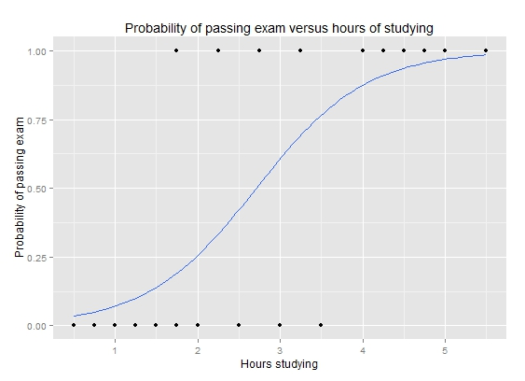
Application
A group of 20 students spend between 0 and 6 hours studying for an exam. How does the number of hours spent studying affect the probability that the student will pass the exam?
Hours | 0.50 | 0.75 | 1.00 | 1.25 | 1.50 | 1.75 | 1.75 | 2.00 | 2.25 | 2.50 | 2.75 | 3.00 | 3.25 | 3.50 | 4.00 | 4.25 | 4.50 | 4.75 | 5.00 | 5.50
Pass | 0 | 0 | 0 | 0 | 0 | 0 | 1 | 0 | 1 | 0 | 1 | 0 | 1 | 0 | 1 | 1 | 1 | 1 | 1 | 1
Using R/MiniTab/SAS
 | Coefficient | Std.Error | z-value | P-value (Wald)
Intercept | −4.0777 | 1.7610 | −2.316 | 0.0206
Hours | 1.5046 | 0.6287 | 2.393 | 0.0167
P =
1
1+ e [ - { (1.5046 * Hours) – 4.0777} ]

Slide 7
Application
Hours | 0.50 | 0.75 | 1.00 | 1.25 | 1.50 | 1.75 | 1.75 | 2.00 | 2.25 | 2.50 | 2.75 | 3.00 | 3.25 | 3.50 | 4.00 | 4.25 | 4.50 | 4.75 | 5.00 | 5.50
Pass | 0 | 0 | 0 | 0 | 0 | 0 | 1 | 0 | 1 | 0 | 1 | 0 | 1 | 0 | 1 | 1 | 1 | 1 | 1 | 1
P =
1
1+ e [ - { (1.5046 * Hours) – 4.0777} ]
Hours of study | Probability of passing exam
1 | 0.07
2 | 0.26
3 | 0.61
4 | 0.87
5 | 0.97

Slide 8
Logistic Regression
Strengths
Can have mixed continuous and categorical predictor variables.
Results are already on probability scale.
Can handle the case of a consumer making decisions multiple times.
Good to use where the consumer cannot be asked directly which attributes he considers most important.
Weaknesses
Model validation is sensitive to segmentation and decision structure.
For categorical predictor variables that are converted to dummy variables, there is currently no effective mechanism for engineering the model.

Slide 9
Decision Tree
A decision tree is an approach to predictive analysis that can help you make decisions.
A decision tree is a data structure where each non-leaf node specifies a test of some attribute. We start from the root node of such a tree and—according to test outcomes—move down tree branches until the bottommost leaf nodes are encountered. These nodes hold some class label, or the values of the target attributes.

Slide 10
Advantage of Decision Tree
Interpretable at a glance
Suitable for handling both categorical and quantitative values
Universal for solving both classification and regression problems
Capable of handling missing values in attributes and filling them in with the most probable value
High-performing with regard to searching down a built tree, because the tree traversal algorithm is efficient even for massive data sets

Slide 11
Example of decision tree for investment
you need to decide whether to invest a certain amount of money in one of three business projects: a food-truck business, a restaurant, or a bookstore.
Business | Success Rate | Failure Rate
Food Truck | 60 percent | 40 percent
Restaurant | 52 percent | 48 percent
Bookstore | 50 percent | 50 percent
Business | Gain (USD) | Loss (USD)
Food Truck | 20,000 | -7,000
Restaurant | 40,000 | -21,000
Bookstore | 6,000 | -1,000

Slide 12
Decision tree model
Using such a decision tree to decide on a business venture begins with calculating the expected value for each alternative — a numbered rank that helps you select the best one.
The expected value of a restaurant business represents a prediction of how much profit you’d make (on average) if you invested in a restaurant business several times. Therefore the expected value becomes one of the criteria you figure into your business decision-making. In this example, the expected values of the three alternatives might incline you to favor investing in the restaurant business.

Slide 13
Sample of Decision Tree
Notes:
This decision tree predicts whether a customer might buy a given watch at the online store. The nodes in this decision tree represent some of the attributes you’re analyzing; each is a score — of customer interest in watches, customer age, and customer salary.
Applying the model to a new Customer X, you can trace a path from the root of the tree down to a decision tree’s leaf (yes or no) that indicates and maps how that customer would behave toward the watch being advertised.

Slide 14
KNN
In the k-Nearest Neighbor prediction method, the Training Set is used to predict the value of a variable of interest for each member of a target data set. The structure of the data generally consists of a variable of interest (i.e., amount purchased), and a number of additional predictor variables (age, income, location).
1. For each row (case) in the target data set (the set to be predicted), locate the k closest members (the k nearest neighbors) of the Training Set. A Euclidean Distance measure is used to calculate how close each member of the Training Set is to the target row that is being examined.
2. Find the weighted sum of the variable of interest for the k-nearest neighbors (the weights are the inverse of the distances).
3. Repeat this procedure for the remaining rows (cases) in the target set.
4. XLMiner allows the to selection of a maximum value for k, builds models in parallel on all values of k (up to the maximum specified value), and performs scoring on the best of these models.

Slide 15
This example illustrates the use of XLMiner’s k-Nearest Neighbors Prediction method.
This data set contains 14 variables described in the table below. The dependent variable MEDV is the median value of a dwelling. The objective of this example is to predict the value of this variable
CRIM | Per capita crime rate by town
ZN | Proportion of residential land zoned for lots over 25,000 sq.ft.
INDUS | Proportion of non-retail business acres per town
CHAS | Charles River dummy variable (= 1 if tract bounds river; 0 otherwise)
NOX | Nitric oxides concentration (parts per 10 million)
RM | Average number of rooms per dwelling
AGE | Proportion of owner-occupied units built prior to 1940
DIS | Weighted distances to five Boston employment centers
RAD | Index of accessibility to radial highways
TAX | Full-value property-tax rate per $10,000
PTRATIO | Pupil-teacher ratio by town
B | 1000(Bk - 0.63)^2 where Bk is the proportion of blacks by town
LSTAT | % Lower status of the population
MEDV | Median value of owner-occupied homes in $1000's

Slide 16
A portion of the data set is shown below. The last variable, CAT. MEDV, is a discrete classification of the MEDV variable, and will not be used in this example.

Slide 17
Result of Boston Housing

Slide 18
LINEAR REGRESSION MODELS
A model is linear when each term is either a constant or the product of a parameter and a predictor variable. A linear equation is constructed by adding the results for each term. This constrains the equation to just one basic form:
Response = constant + parameter * predictor + ... + parameter * predictor
Y = b _{o} + b₁X₁ + b₂X₂ + ... + b_{k}X_{k}
In statistics, a regression equation (or function) is linear when it is linear in the parameters. While the equation must be linear in the parameters, you can transform the predictor variables in ways that produce curvature. For instance, you can include a squared variable to produce a U-shaped curve.
Y = b _{o} + b₁X₁ + b₂X₁²

Slide 19
LINEAR REGRESSION MODELS
A model is still linear in the parameters even though the predictor variable is squared. We can also use log and inverse functional forms that are linear in the parameters to produce different types of curves.
Here is an example of a linear regression model that uses a squared term to fit the curved relationship between BMI and body fat percentage

Slide 20
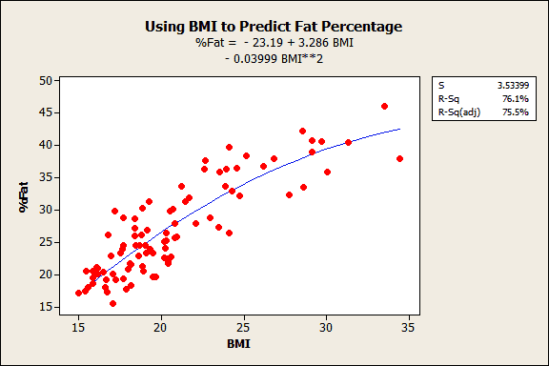
LINEAR REGRESSION MODELS

Slide 21
LINEAR REGRESSION MODELS
TYPES OF LINEAR MODELS:
Significant improvements to the following types of linear models have been made:
Factorial Designs
General Full Factorial Designs
Analyze Variability
Response Surface Designs
General Linear Models (GLM)
Regression
Binary Logistic Regression
Poisson Regression

Slide 22
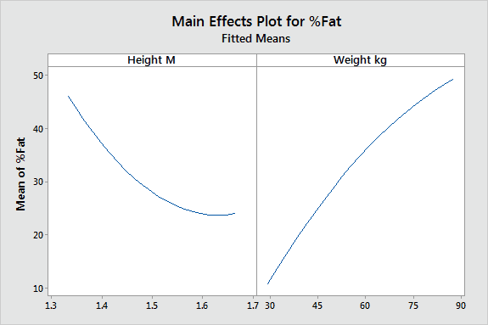
MAIN EFFECTS PLOT FOR THE EXAMPLE:

Slide 23
MAIN EFFECTS PLOT FOR THE EXAMPLE:
The main effects plot and interactions plot are available for types of linear models that they weren't before. Even better is the ability to produce these plots for continuous variables, rather than just categorical variables. This ability is particularly helpful when you want to understand interactions between continuous variables, which are to notoriously difficult to interpret using the numerical output.
This main effects plot is based on continuous variables. It is reflected in the curvature in the model.

Slide 24
Advantages
Quantification is possible only in linear regression.
It is simpler to solve.
It requires lesser time and effort than multivariate regression models.
Disadvantages
The dependent variable must be continuous, in that it can take on any value, or at least close to continuous.
Linear Regression Is Limited to Linear Relationships
Linear Regression Only Looks at the Mean of the Dependent Variable
Linear Regression Is Sensitive to Outliers
Data Must Be Independent

Slide 25
Time Series
WHAT IS TIME SERIES
A time series is a series of data points indexed (or listed or graphed) in time order. Most commonly, a time series is a sequence taken at successive equally spaced points in time. Thus it is a sequence of discrete-time data. Examples of time series are heights of ocean tides, counts of sunspots, and the daily closing value of the Dow Jones Industrial Average.
WHERE IT IS PLOTTED
Time series are very frequently plotted via line charts. Time series are used in statistics, signal processing, pattern recognition, econometrics, mathematical finance, weather forecasting, earthquake prediction, electroencephalography, control engineering, astronomy, communications engineering, and largely in any domain of applied science and engineering which involves temporal measurements.

Slide 26
METHODS FOR ANALYSIS
METHODS FOR ANALYSIS
Methods for time series analysis may be divided into two classes: frequency-domain methods and time-domain methods. The former include spectral analysis and wavelet analysis; the latter include auto-correlation and cross-correlation analysis. In the time domain, correlation and analysis can be made in a filter-like manner using scaled correlation, thereby mitigating the need to operate in the frequency domain.
Additionally, time series analysis techniques may be divided into parametric and non-parametric methods. The parametric approaches assume that the underlying stationary stochastic process has a certain structure which can be described using a small number of parameters (for example, using an autoregressive or moving average model). In these approaches, the task is to estimate the parameters of the model that describes the stochastic process. By contrast, non-parametric approaches explicitly estimate the covariance or the spectrum of the process without assuming that the process has any particular structure.
Methods of time series analysis may also be divided into linear and non-linear, and univariate and multivariate.

Slide 27
EXAMPLE
This example illustrates the use of a vector error-correction (VEC) model as a linear alternative to the Smets-Wouters Dynamic Stochastic General Equilibrium (DSGE) macroeconomic model, and applies many of the techniques of Smets-Wouters to the description of the United States economy.
The USA economy time series example link is attached below
https://drive.google.com/file/d/1MpJguT37MqW60VPoz3EhWDfmhGrdhxuk/view?usp=sharing

Slide 28
Advantages
The main advantage of a time series is in its future data value prediction capability
Time series data have a natural temporal ordering This makes the analysis distinct from cross-sectional studies, in which there is no natural ordering of the observations
Disadvantages
Time series methods draw on vastly different areas in statistics with no real unification of the theory, either.
The pattern and its study is complicated.

Slide 29
Thank You！

